Slide 1
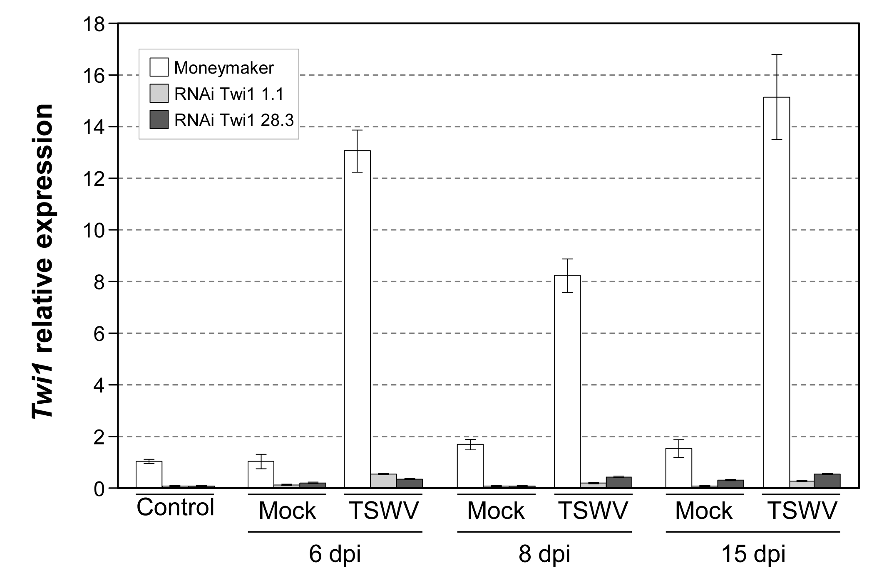
Figure S6
Fig. S6. Twi1 gene expression in the RNAi Twi1 transgenic tomato plants after inoculation with Tomato spotted wilt virus (TSWV). A quantitative reverse transcription-polymerase chain reaction (qRT-PCR) analysis of Twi1 gene expression in the leaves from the TSWV-inoculated and Mock-inoculated leaves from the Moneymaker and RNAi Twi1 transgenic tomato lines. The control shows Twi1 gene induction before virus inoculation. The Elongation Factor 1 alpha gene was used as an endogenous reference. The results correspond to the means±SD of three independent plants from a representative experiment. The experiment was repeated 3 times.

